Slide 1
Introduction to ModelMuse
New England Science Center
Nov. 17-19, 2015

Slide 2
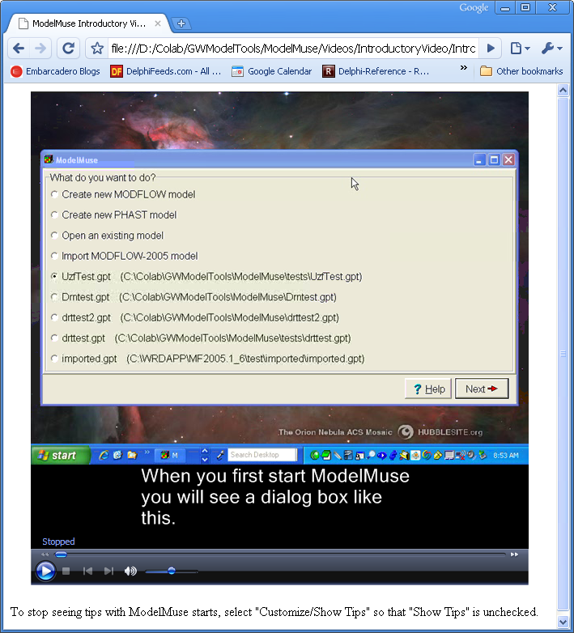
Videos Give Tips on ModelMuse
Notes:
2

Slide 3
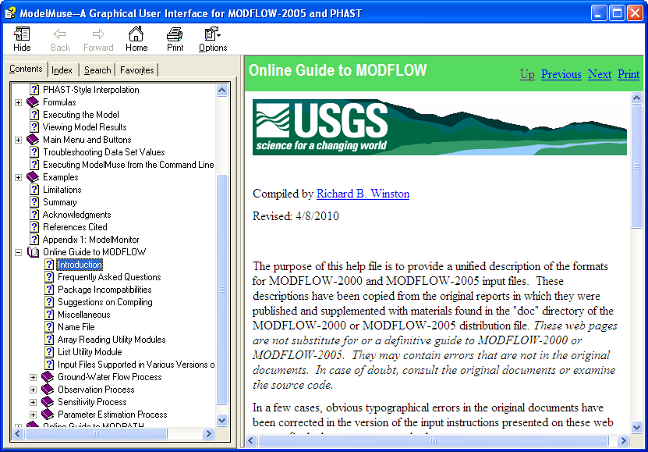
Reference Materials
Notes:
3

Slide 4
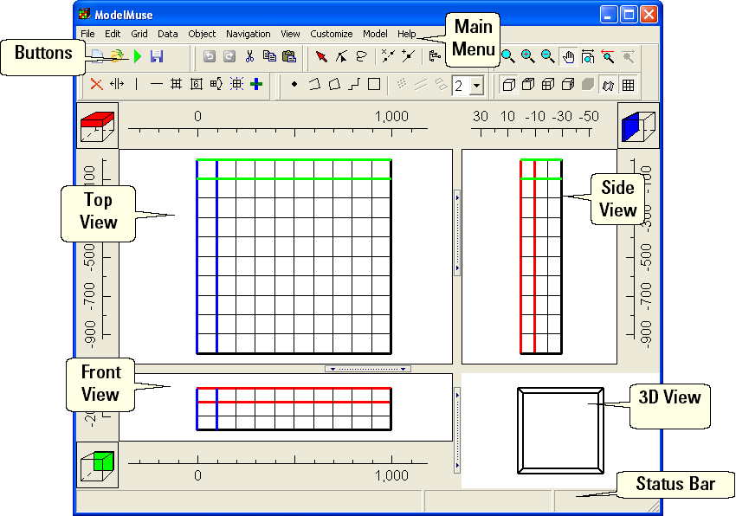
Main Form
Notes:
4

Slide 5
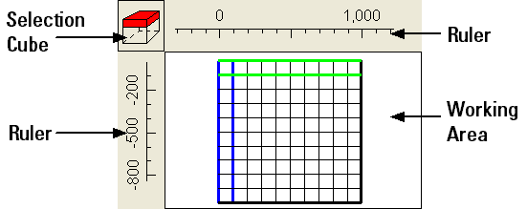
Top, Front, and Side Views
Notes:
5

Slide 6
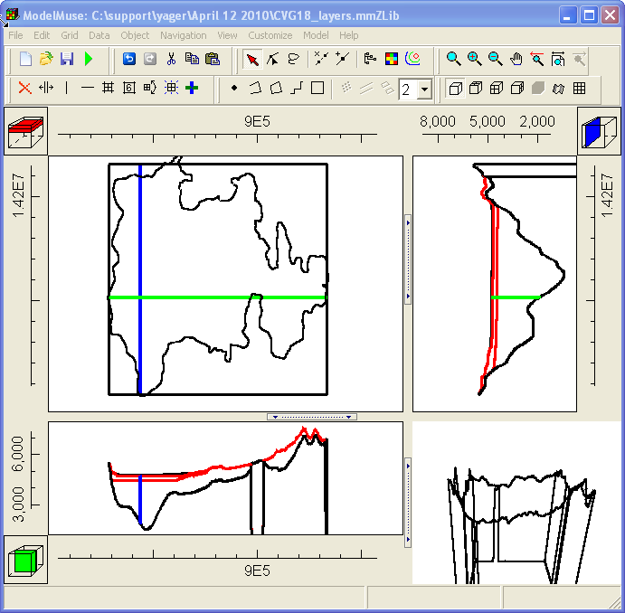
Colored Lines Indicate Selected Column, Row, and Layer
Notes:
6

Slide 7
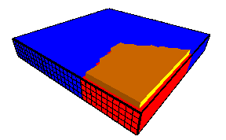
3D View
Notes:
7

Slide 8
Navigation
Zoom
Zoom in
Zoom out
Pan
Undo change in view
Default view
Redo change in view
Notes:
8

Slide 9
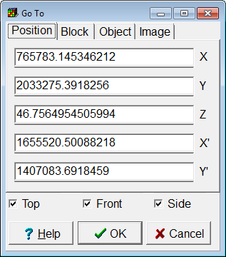
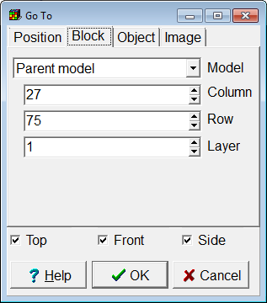
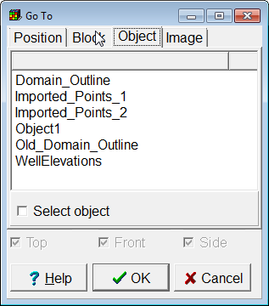
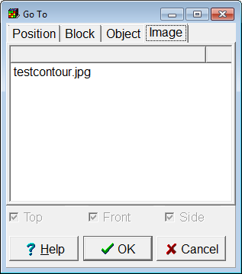
Go To Position, Block, Object, or Image
Notes:
9

Slide 10
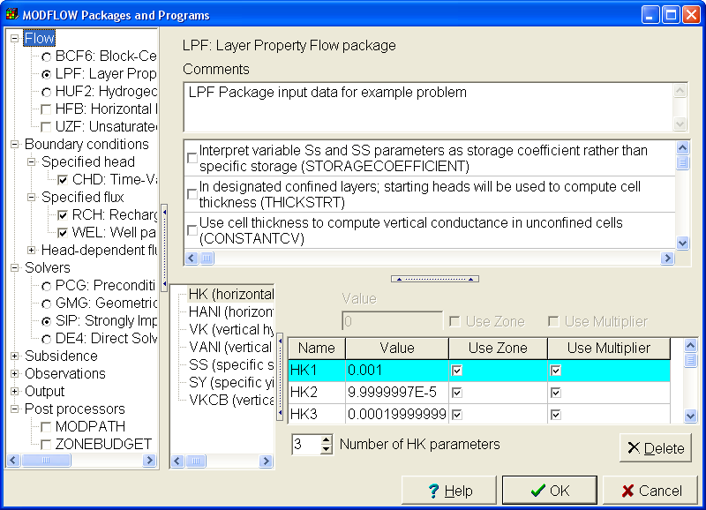
MODFLOW Packages and Programs Dialog Box
Notes:
10

Slide 11
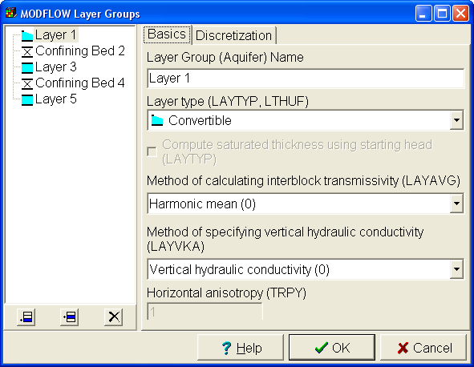
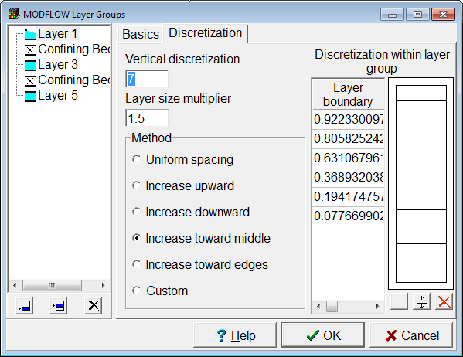
MODFLOW Layer Groups Dialog Box
Notes:
11

Slide 12
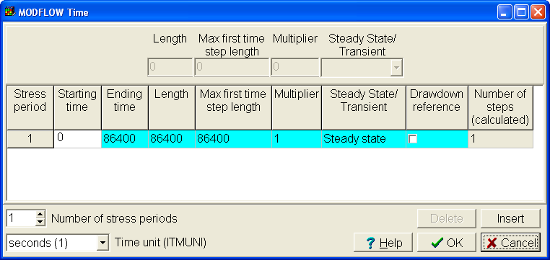
MODFLOW Time Dialog Box
Notes:
12

Slide 13
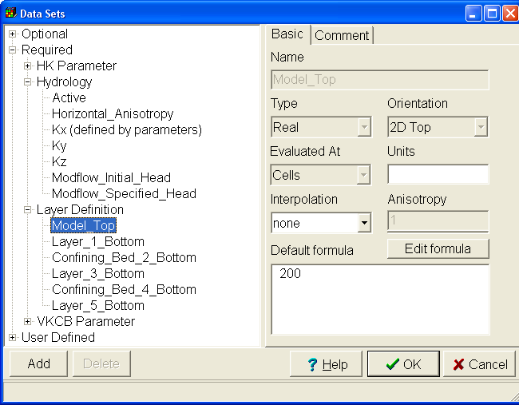
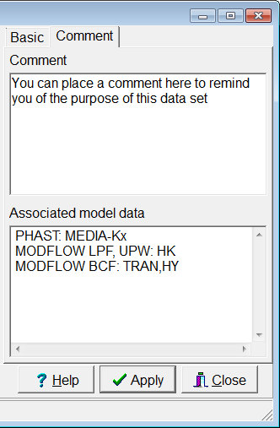
Data Sets Dialog Box
Notes:
13

Slide 14
Data Set Properties
Array of values corresponding to grid cells
Name
Type
Orientation
Interpolation algorithm
Default Formula
Comment
Notes:
14

Slide 15
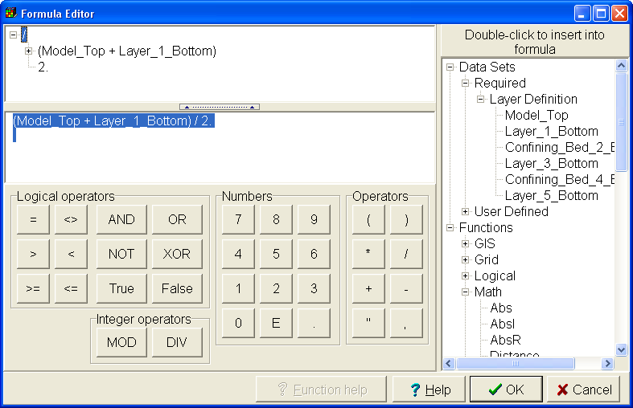
Formula Editor
Notes:
15

Slide 16
Formulas
Mathematical expressions used to assign values to data sets
May result in different values at different locations
(Model_Top + Layer_1_Bottom) / 2.
CaseR(Layer, 0., 1E-6, 0., 0., 0.)
Notes:
16

Slide 17
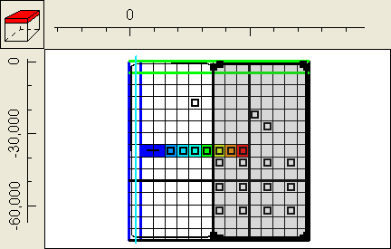
Objects
Notes:
17

Slide 18
Objects
Points, Polylines, Polygons
Have 0, 1, or 2 third dimension formulas
Assign values to data sets and boundary conditions
May have multiple sections
Notes:
18

Slide 19
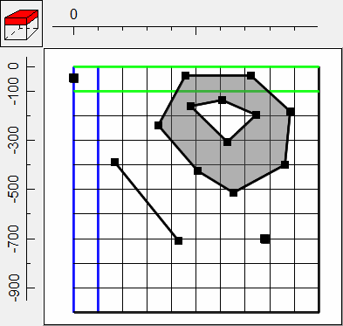
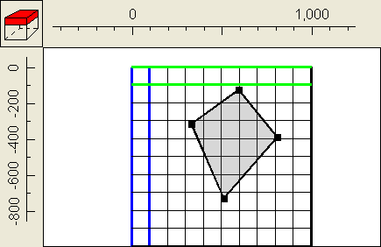
Creating Objects
Create objects
Add sections to objects
Object with multiple sections of different types
Object with a single section
Notes:
19

Slide 20
Editing Objects
Select object
Select a vertex
Delete a segment
Add a vertex
Associate a value with a vertex
Show or hide objects
Others
Notes:
20

Slide 21
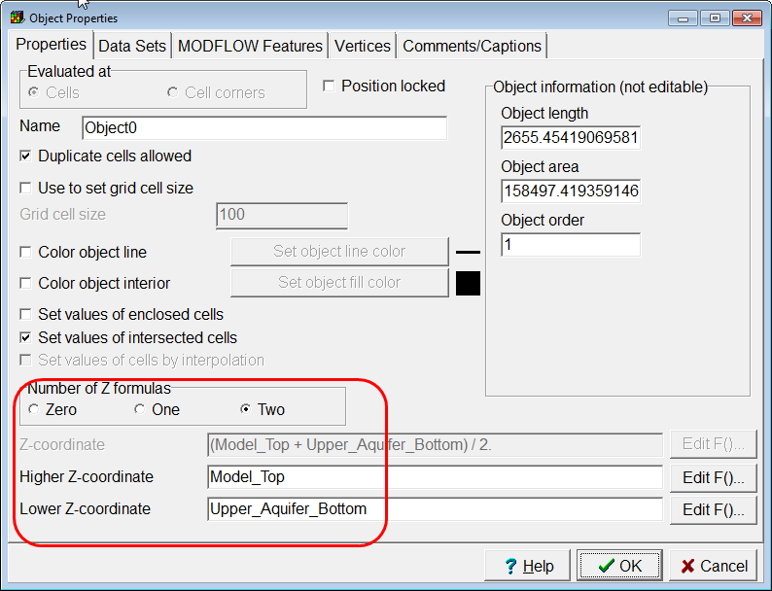
Object Properties Dialog Box
Use numbers or formulas to specify vertical position of objects
Notes:
21

Slide 22
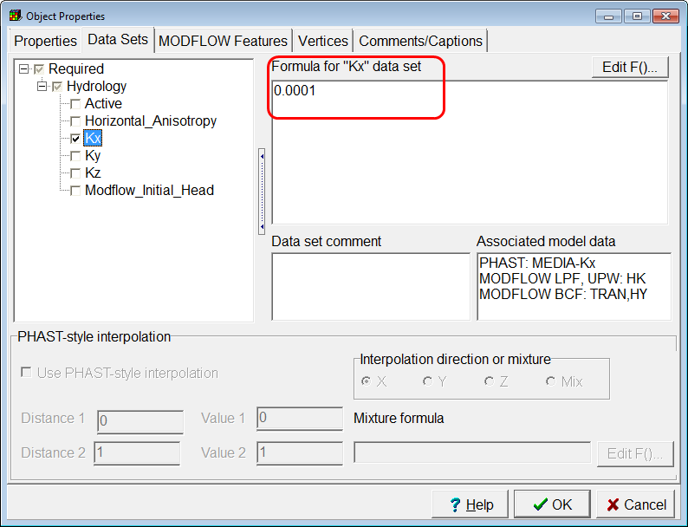
Assign Data Set Values with Objects
Set values of data sets using numbers or formulas.
Notes:
22

Slide 23
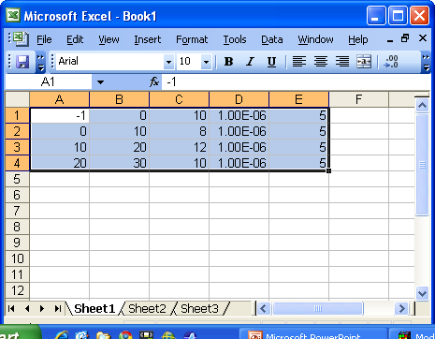
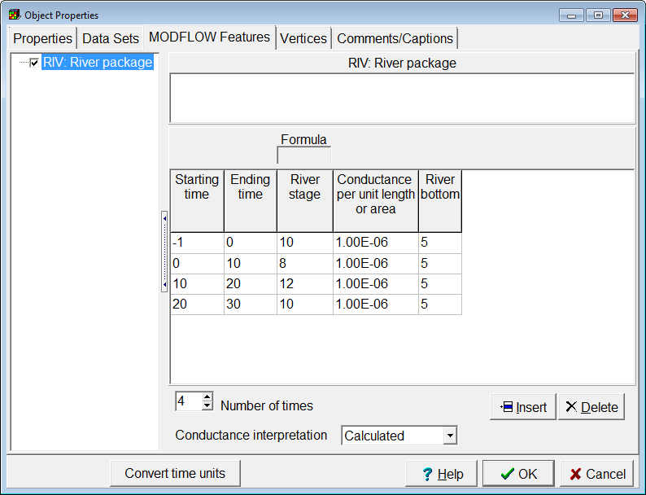
Object Properties Dialog Box
Copy from spreadsheets into ModelMuse tables
Notes:
23

Slide 24
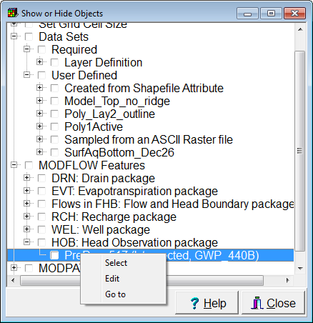
Show and Hide Objects
Notes:
24

Slide 25
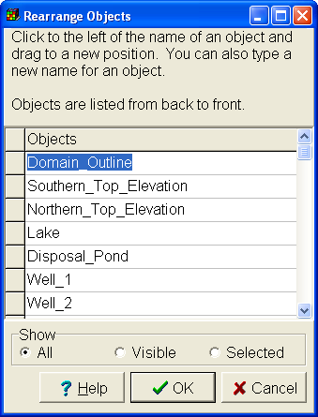
Object Order is Important
Notes:
25

Slide 26
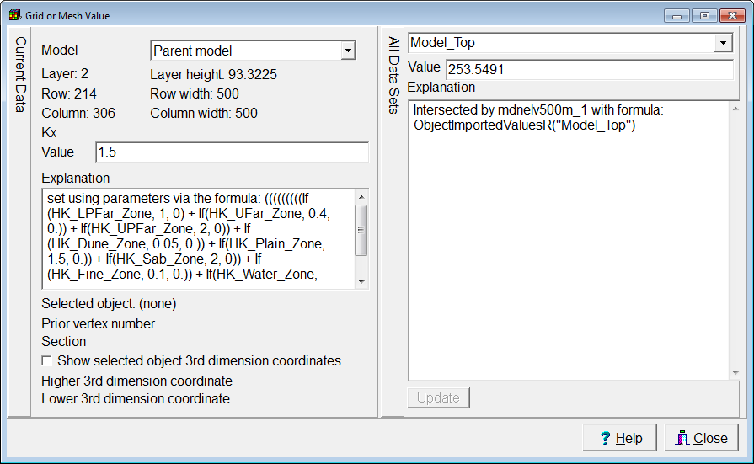
Grid or Mesh Value Dialog Box
Notes:
26

Slide 27
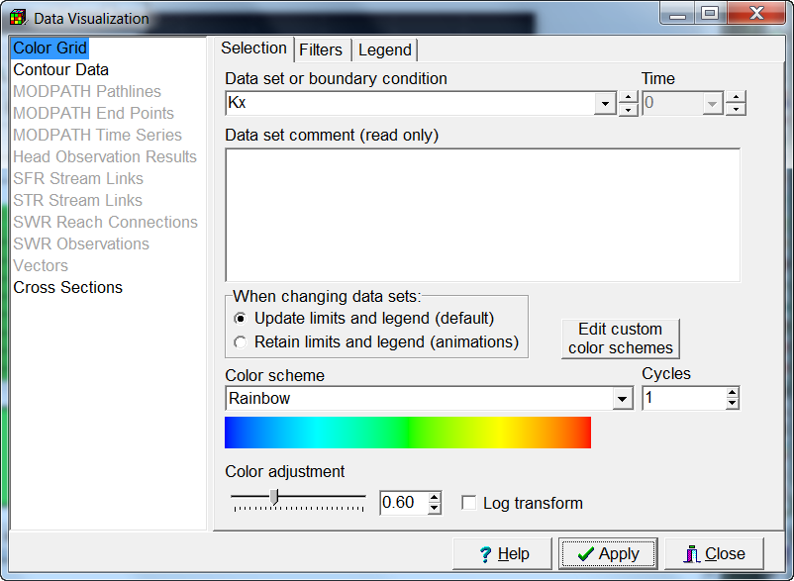
Data Visualization Dialog Box
Notes:
27

Slide 28
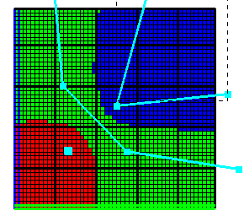
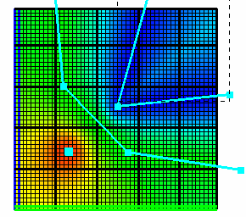
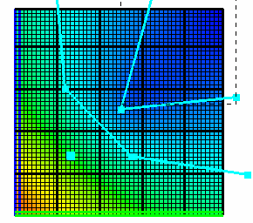
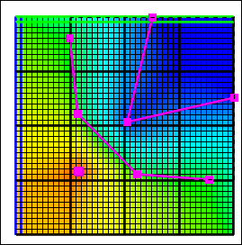
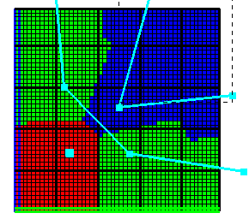
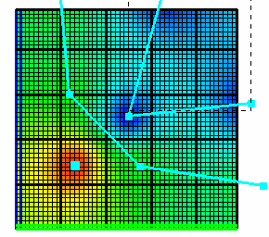
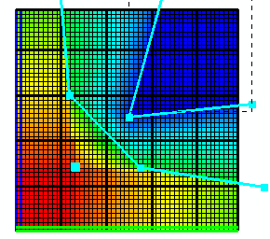
Interpolation Methods
Nearest
Inv. Dist. Sq
Fitted Surface
Natural Neighbor
Nearest Point
Point Inv. Dist. Sq.
Triangle Interp.
Notes:
28

Slide 29
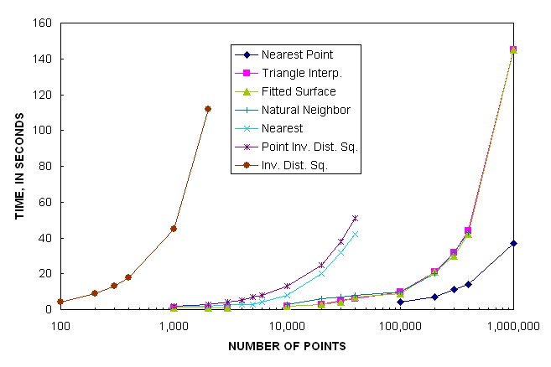
Interpolation Speed
Notes:
29

